Slide 1
Developing with .NET Core on AWS - what’s new
DEV318
Norm Johanson
Senior Software Developer
Amazon Web Services
@socketnorm
Steve Roberts
Senior Technical Evangelist
Amazon Web Services
@bellevuesteve

Slide 2
What’s new for .NET on AWS

Slide 3
.NET and .NET Core on AWS - latest news!
New! AWS .NET Developer Center https://aws.amazon.com/net/
New! Central repository for everything .NET at AWS https://github.com/aws/dotnet
.NET Core 2.1 AWS Lambda Support
The AWS Lambda Tools for PowerShell
AWS Tools for Visual Studio Team Services version 1.1

Slide 4
Modern .NET applications on AWS

Slide 5
Introducing our Simple Elastic Mosaic Processing Application
What does it do?
How was it built?
What services were used?
What problems were solved?

Slide 6
What are we going to learn?
Modern application architecture using Serverless and containers
Lambda debugging techniques
Using new AWS extension libraries in our application
CI/CD with the AWS Code services

Slide 7
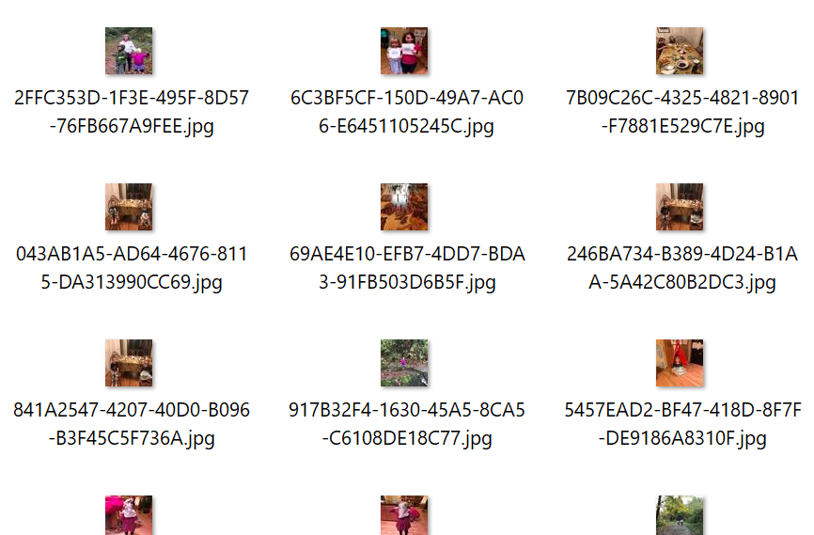



What is a mosaic image?
+
Tile Gallery

Slide 8



Overall architecture
Application
Tile Data
Mosaic tile gallery
ingestion
Upload tile gallery images
Processed Tiles
Tile Gallery
Tiles
Mosaic rendering
Upload image file
Output mosaic

Slide 9
Mosaic tile gallery ingestion

Slide 10
What does tile ingestion do?
Accepts zip file from user containing multiple images
Analyzes each image to create tile information
Resizes each image and save as a tile in a named gallery

Slide 11







How tile ingestion works
Tile images (zip)
Image Moderation
Job Queue
Process Image
Image upload
Tile Color Data
Tile Storage
Container Image

Slide 12


Why did we choose AWS Batch?
Job Definition
Job Queue
Take advantage of Serverless
Manages the compute capacity for us
Work can be queued for asynchronous processing
Tile creation is not a time critical task
Cost savings
No charge for idle compute environments.
Ability to use EC2 spot instances
Job 1
Job 2
…
Job N
Compute Environment
Spot Instance(s)
On-demand Instance(s)

Slide 13
Demo: tile ingestion

Slide 14
What did we learn?
Using Dead Letter Queues to help diagnose failures
Using the Mock Lambda Test Tool to replay and debug events
Using .NET Core Global Tools in CI/CD pipelines
How to use AWS Batch

Slide 15
Mosaic rendering

Slide 16
What does mosaic rendering do?
Accepts an image file from the user and name of a tile gallery
Analyzes the image against the tile data in the gallery
Builds mosaic image using the matched tiles

Slide 17
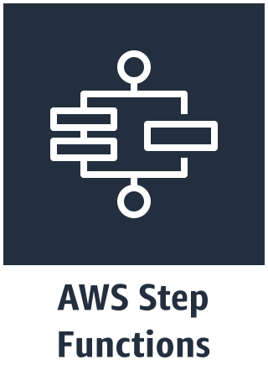

How mosaic rendering works
Input image
Tile Data
Output Mosaic
Trigger (API call or event)
Small Render
Subscribers
Color Map
Select Tiles (F#)
Medium Render
Completion Notification
Large Render

Slide 18
Demo: mosaic rendering

Slide 19
What did we learn?
How to use Step Functions to orchestrate a workflow
How to use the .NET Mock Lambda Test Tool to debug a request input
How to deploy multiple projects with a serverless template

Slide 20
Web front-end

Slide 21
What does the web front-end do?
Allows an authenticated user to:
Upload zip of images for new tile galleries
Upload an image to create a mosaic

Slide 22


How the web front-end works
Web Server Clusters
Tile Import
Render Mosaic
Image file
User Pool
Container Image

Slide 23
Demo: hosting the web front-end

Slide 24
What did we learn?
Use our upcoming high level libraries to handle identity, data protection and configuration
Call AWS Batch and AWS Step Functions
Share configuration with AWS SSM Parameter Store
Deploying containers to AWS Fargate with AWS CodePipeline

Slide 25
Upcoming library repositories on GitHub
ASP.NET Core Identity Provider for Amazon Cognito https://github.com/aws/aws-aspnet-cognito-identity-provider
IConfiguration Provider for AWS SSM Parameter Store https://github.com/aws/aws-dotnet-extensions-configuration
ASP.NET Core DataProtection Provider for AWS SSM https://github.com/aws/aws-ssm-data-protection-provider-for-aspnet

Slide 26
Revisiting the architecture

Slide 27

Tile Gallery
Process Tile Image
Image Moderation
Job Queue
Web Front End
Image upload
Tile Color Data
Web Server Clusters
Parameter Store
Container Image
Tile Storage
Mosaic Rendering
Output Mosaic
User Pool
Container Image
Small
Map Colors
Select Tiles (F#)
Medium
Notify
Large

Slide 28
Session wrap

Slide 29
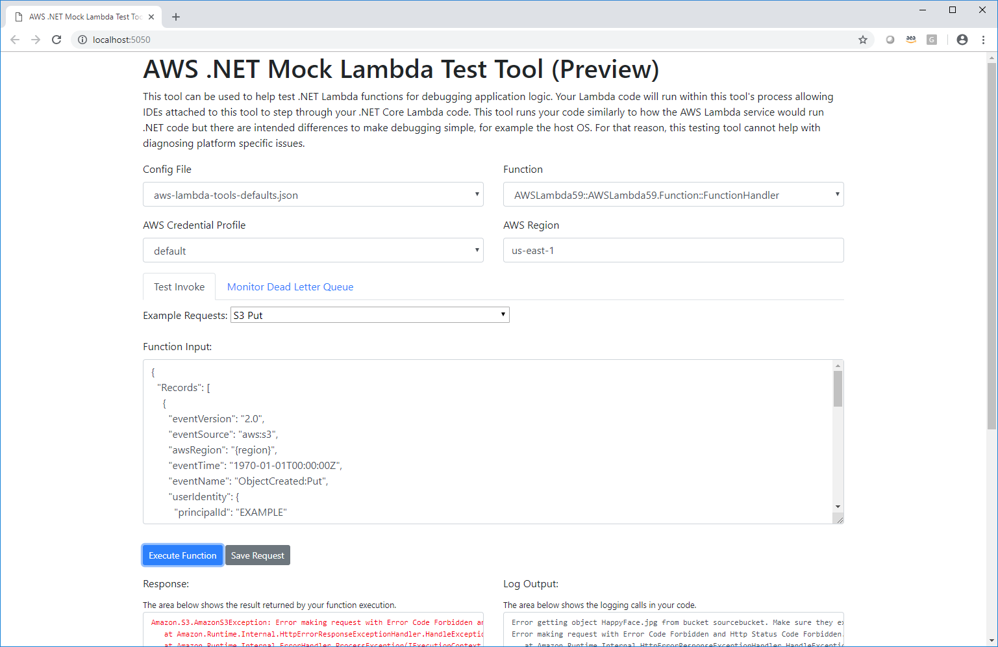
AWS .NET Mock Lambda Test Tool (Preview)
Open Source
https://github.com/aws/aws-lambda-dotnet/
AWS Toolkit for Visual Studio will auto configure
Visual Studio Code and JetBrains Rider instructions in README:
Tools/LambdaTestTool/README.md

Slide 30
Useful links
AWS .NET Blog: https://aws.amazon.com/blogs/developer/tag/net/
AWS .NET Twitter Handle: @awsfornet
GitHub:
AWS SDK for .NET: https://github.com/aws/aws-sdk-net
AWS Lambda for .NET Core: https://github.com/aws/aws-lambda-dotnet
AWS .NET Global Tools: https://github.com/aws/aws-extensions-for-dotnet-cli
Upcoming Visual Studio Code Toolkit:
https://github.com/aws/aws-toolkit-vscode

Slide 31
Norm Johanson
@socketnorm
Steve Roberts
@bellevuesteve

